Slide 1

Explaining Student Behaviour at Scale
The Influence of Video Complexity on Student Dwelling Time
Frans van der Sluis
f.van.der.sluis@fgga.leidenuniv.nl
Notes:
How emotion of interest can be explained through the complexity of text

Slide 2
Introduction

Slide 3
From learning at scale
To learning about learning
Notes:
Central proposition

Slide 4
Objective
Understanding why and how students interact with educational videos is essential to further improve the quality of Massive Online Open Courses (MOOCs).
Notes:
Videos make up most of the educational content in MOOCs. This makes it important to better understand how students interact and engage with educational videos.

Slide 5
Status quo
Granular analyses
        — Clicks
        — Seek actions
        — Video length
Big predictions
        — Perceived difficulty
        — Dropouts
        — Engagement
Guo (2014): 6 minutes length optimal for engagement
Notes:
The analysis of student behavior through clicks tends to be too granular for sense-making; that is, to be able to unam- biguously assign meaning to clicks and subsequently explain student behavior [28].
E.g., six minutes guideline!

Slide 6
Video dwelling time
A definition
        — Time on task, relative to video length
Some common ideas:
        — Struggling students need more time (Li, 2015)
        — Interested students spend more time (Guo, 2014)
Do they hold?
Notes:
The analysis of student behavior through clicks tends to be too granular for sense-making; that is, to be able to unam- biguously assign meaning to clicks and subsequently explain student behavior [28].

Slide 7
Research on text
Interest
        — Reduces dwelling time
Difficulty
        — Increase dwelling time
        — But can also decrease dwelling time
Notes:
The analysis of student behavior through clicks tends to be too granular for sense-making; that is, to be able to unam- biguously assign meaning to clicks and subsequently explain student behavior [28].

Slide 8
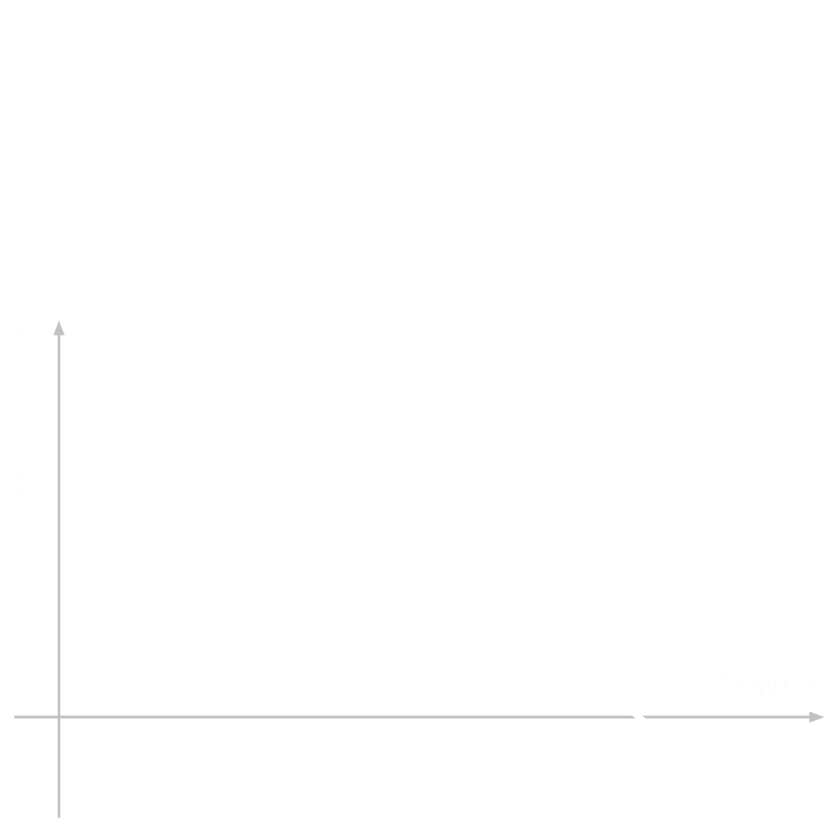

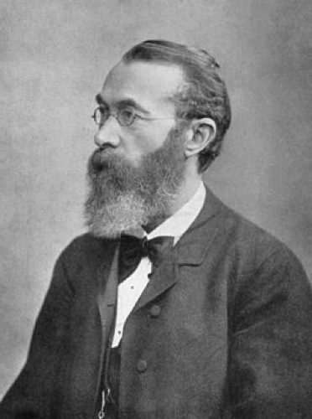
Wundt-curve (1896)
Interest increases with stimulus complexity, up till the point of (in)comprehensibility (Berlyne, 1966; Silvia, 2008)
Notes:
Berlyne observed that attributes such as novelty and complexity increase attractiveness of a stimulus, but only up to a certain point.
This so-called Wundt-curve begs the question to understand what drives interest down again.

Slide 9
Two Hypotheses
Dwelling time increases in videos
        — With low information complexity
        — With high information complexity
If interest indeed decreases dwelling time…
Notes:
The analysis of student behavior through clicks tends to be too granular for sense-making; that is, to be able to unam- biguously assign meaning to clicks and subsequently explain student behavior [28].

Slide 10
Methodology

Slide 11
Three Aims
Analyse dwelling time
Analyse video complexity
Explain dwelling time using video complexity
Notes:
only discuss the processing difficulty / psycholinguistics

Slide 12
First Challenge
To derive a reliable estimator of dwelling time
        — Using click-stream data
        — Relative to video duration
        — Based on clicks (seeks, pauses, etc.)
        — Incomplete data (pauses, video ends)
Notes:
only discuss the processing difficulty / psycholinguistics

Slide 13

Click-stream data
Our solution
        — Video “sections” (in-video quizes)
        — Only students who finished watching a section
        — Total of 471,179 session
        — Including (time) excluding (rate) pause-time
Course | Videos | Sessions
configuringworld001 | 37 | 46,839
globalorder001 | 21 | 112,744
humanlanguage001 | 27 | 270,333
internationaltaxation001 | 10 | 34,213
metals001 | 6 | 6,356

Slide 14
Second Challenge
Derive a valid estimation of video complexity
        — From spoken words
              (especially for MOOCs)
        — Visual and auditory information
        — Account for time and speed
        — Needs to explain actual behaviour!
Notes:
only discuss the processing difficulty / psycholinguistics

Slide 15
Analyse transcripts
Our solution
        — Analyse video transcripts on 8 features
        — Integrate multiple psycholinguistic methods
        — Account for time difference (information rate)
        — Train model using Wikipedia, apply to Coursera
Notes:
only discuss the processing difficulty / psycholinguistics

Slide 16
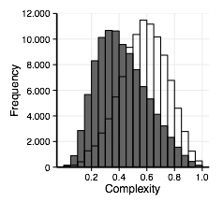
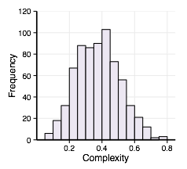
Analysis of Complexity
(a) Wikipedia
(b) Coursera

Slide 17
Results

Slide 18
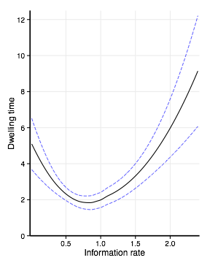
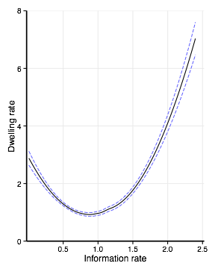
Analysis of Results
(a) Dwelling time
(b) Dwelling rate
dwelling rate = 3.20 − 5.37 × video complexity + 3.02 × video complexity²
R² = 22.44% of explained variance (SE = 1.32, F(2,451679) = 65330, p < .001).

Slide 19
Conclusion
~22% of total variance in dwelling rate explained by complexity model
        — Effects as expected
              — Low complexity makes it difficult to stay concentrated
              — High complexity troubles understanding the content
        — Effects of models on information processing reaches beyond the lab
        — Yet no direct evidence for theory on interest
        — And data-driven means data-dependent

Slide 20
Discussion

Slide 21
Implications of Findings
Validity of our model of objective complexity
        — Strong foundation in psycholinguistics
        — Applied to distinctive data sets
        — Affects actual information behaviour
        — Effects of models on information processing reaches beyond the lab
Dwelling time
        — Can be observed during information interaction
        — But is it a proxy of difficulty, interest, or learning?

Slide 22
On sense-making
  In and of itself, dwelling rate and time are not directly interpretable and as such cannot function as a proxy measure of (perceived) difficulty nor of other related constructs.
  Any interpretation of a proxy of behaviour becomes plausible once controlling for related variables - such as video complexity - that are theoretically expected to explain it.
  To allow for sense-making from learning analytics, it is critical to select well-supported metrics with known theoretical relations.

Slide 23
Features

Slide 24
Features
Traditional
Priming
Lexical Familiarity
Dependency-locality

Slide 25
Features
F1: word length in characters
F2: word length in syllables
F3: Dale frequency
F4: Sentence length
Traditional
Feature 6: character-n-gram SWE of a text
Feature 7: word-n-gram SWE of a text
Priming
Feature 5: logarithm of word count per word in a representative collection (Google Books n-grams)
Lexical Familiarity
Feature 8: Integration costs of a sentence containing dependencies
Dependency-locality

Slide 26
Features
Dependency-Locality Theory
        “While reading, a moment-by-moment integration of new information with existing information”
                > The reporter disliked the editor
                > The reporter who the senator attacked disliked the editor
                > The reporter who the senator who John met attacked disliked the editor

